Slide 1
2019 Delaware Trust Conference Top 10 Considerations and Challenges for Changing Trust Situs Presented by Margaret E.W. Sager, Esquire Heckscher, Teillon, Terrill & Sager, P.C.
© 2019 Heckscher, Teillon, Terrill & Sager, P.C. All Rights Reserved.

Slide 2
Top 10 Challenges
Understanding situs
Why change situs?
Where do you go?
Which state’s (or states’) laws apply?
Taxes!

Slide 3
Top 10 Challenges (cont.)
What is “trust administration”?
Making the change
Which court(s) has (have) jurisdiction?
Ongoing reevaluation
Duty to change situs / liability?

Slide 4
Challenge 1: Understanding Situs

Slide 5
Different Types of Trust Situs
Administrative situs
Locational situs
Tax situs
Jurisdictional situs

Slide 6
Administrative Situs
Where the administration primarily occurs
AKA “principal place of administration,” especially in UPC and UTC states
UTC §108: “[l]ocating a trust’s principal place of administration will ordinarily determine which court has primary if not exclusive jurisdiction over the trust. It may also be important for other matters, such as payment of state income tax or determining the jurisdiction whose laws will govern the trust.”

Slide 7
Locational Situs
Where assets are located
Intangible property: place of administrative situs (deemed state income tax situs of intangibles may be different)
Real estate and tangible personal property: where the property is physically located (jurisdictional situs as to trust real property may be in a different state)

Slide 8
Tax Situs
Where trust is taxable for state fiduciary income tax purposes WRT retained income and capital gains
Is trust a resident or nonresident trust for state fiduciary income tax purposes?
A trust can be a resident trust for income tax purposes in more than one state
However, a trust can be a resident trust for income tax purposes of no state

Slide 9
Jurisdictional Situs
State court(s) with jurisdiction to hear trust matters
What does trust document say?
Administrative, locational and/or tax situs could play a role
Non-exclusive; multiple states can exercise jurisdiction
Court may decline to exercise jurisdiction it if it concludes that another court is better positioned to exercise jurisdiction

Slide 10
Challenge 2: Why Change Situs?
Alluring Appeal of Another State’s Laws
Income Tax Considerations
Convenience

Slide 11
ACTEC Survey
Prepared for June 2019 Fiduciary Litigation Committee presentation
Panelists: Margaret Sager, Shane Kelley and Mary Akkerman
Shane Kelley conducted straw poll from ACTEC Fellows
Charts prepared by Shane Kelley

Slide 12
Audience Poll #1
Have you ever been involved in a trust administration where the situs was transferred to another state?
Yes
No

Slide 13
https://experience.eventmobi.com/event/38260/question/472586/live-results/351ae50731e42d57c489e5b7c959332f467c0b7bd26af70d060d1775227173cf/live_poll/5997cb11-e106-470f-8144-38cf99f5a67f

Slide 14
Audience Poll #2
How many times have you been involved in a transfer of situs?
1
2-4
5-10
11-14
More than 15

Slide 15
https://experience.eventmobi.com/event/38260/question/472587/live-results/6d2a553e52398b2ab4f0d805ea9656893df44af031f3b297ec1973f7c0a9e634/live_poll/5997cb11-e106-470f-8144-38cf99f5a67f

Slide 16
Audience Poll #3
Indicate three most important reasons for transfer to new jurisdiction
Creditor protection
Protection of trustees
Taxes
Directed Trustee Laws
Decanting Laws
Trust Modification
Geography / Convenience
New Trustee
Knowledge of Courts
Other

Slide 17
https://experience.eventmobi.com/event/38260/question/472591/live-results/ad5b4a13eeb9f928439078bc5d270aba52eee5ad22d3f1a8ea2a9dfc34cef76e/live_poll/5997cb11-e106-470f-8144-38cf99f5a67f

Slide 19
To Review….Per the Survey, Why Change Situs?
Alluring Appeal of Another State’s Laws
Trust Remodeling (56%)
Asset Protection (20%)
Total Return/Power of Adjust (not polled)
Directed Trusts / Trust Protectors (30%)
Silent Trusts (not polled)
State Income Tax (70%)
Convenience (44%)

Slide 20
Challenge 3: Where Do You Go?
What is the Goal?
Alluring appeal - do you get what you want?
State Fiduciary Income Tax Options (do no harm!)

Slide 21
Challenge 3: Where Do You Go? (cont.)
Location(s) of trust assets
Place(s) of administration
Location(s) of trustees
Domicile of beneficiaries
Domicile of settlor

Slide 22
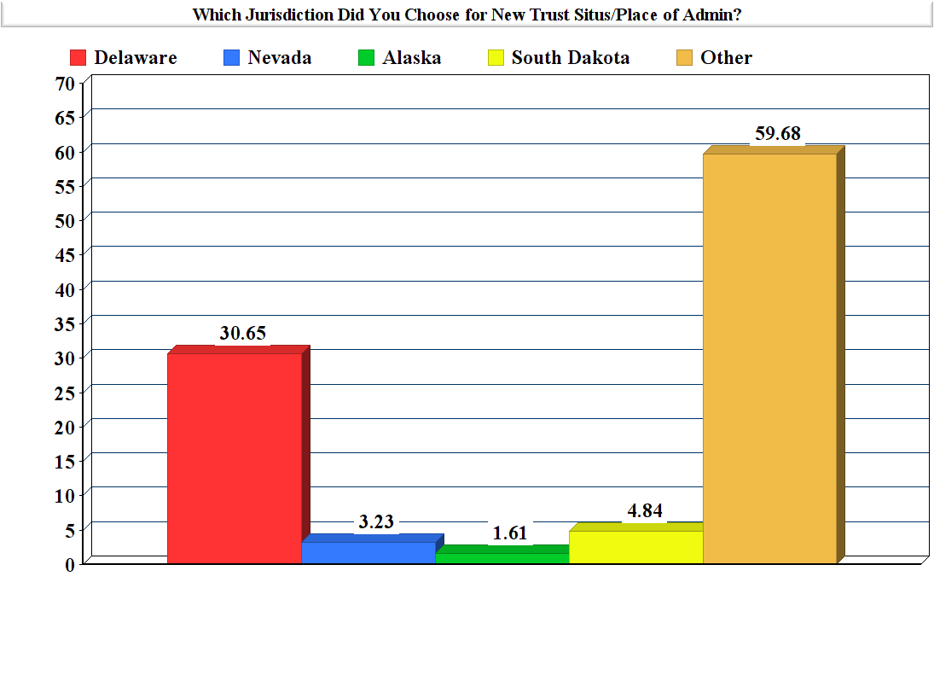

Slide 23
Challenge 4: Which State’s (or States’) Laws Apply?
Governing Instrument Designate Law?
Modify Trust?
Validity & Construction of Original State?
Administration of New State Situs?
What’s What?
Statutory Effect

Slide 24
Audience Poll #4
Do you customarily include choice of law provisions in trust?
Yes
No
Not customarily, but under certain circumstances

Slide 25
https://experience.eventmobi.com/event/38260/question/472592/live-results/d23218280df868281fc0472609ecedfd3f1fe21811e4cef31ec9f55065dc5ddc/live_poll/5997cb11-e106-470f-8144-38cf99f5a67f

Slide 26
Audience Poll #5
Which choice of law provisions do you customarily include?
Validity
Construction
Administration

Slide 27
https://experience.eventmobi.com/event/38260/question/472593/live-results/285d4440dc7921eea1dd867baafe3ba45de8b35fd987f52581d3e6c50b5ae113/live_poll/5997cb11-e106-470f-8144-38cf99f5a67f

Slide 28
Audience Poll #6
Do you include that if situs changes, governing law also changes to new jurisdiction
Yes
No
Not customarily, but under certain circumstances

Slide 29
https://experience.eventmobi.com/event/38260/question/472594/live-results/2893285f2b1db18ff70be3d289b8d99ee8d51310f48517388ed513461f541346/live_poll/5997cb11-e106-470f-8144-38cf99f5a67f

Slide 30
Challenge 5:

Slide 31
A TRUST CAN BE A RESIDENT TRUST FOR FIDUCIARY INCOME TAX PURPOSES
IN MORE THAN ONE STATE;
AND CAN BE A RESIDENT TRUST FOR FIDUCIARY INCOME TAX PURPOSES
IN NO STATE

Slide 32
WHAT MAKES A TRUST A
RESIDENT TRUST
FOR STATE FIDUCIARY INCOME TAX PURPOSES?

Slide 33
Domicile of Settlor/Testator
Domicile of Trustee
Domicile of Beneficiary
Principal Place of Administration

Slide 34
CAN YOU CHANGE IT UP TO ELIMINATE OR
REDUCE STATE FIDUCIARY INCOME TAX?
MAYBE

Slide 35
BEWARE LINGERING CONTACTS!
Trustees
Beneficiaries (?)
Assets
Trust Administration

Slide 36
Challenge 6: What Is “Trust Administration”
Trustee or “Quasi-Trustee” with power to make decisions (e.g., trust protector or investment advisor)
Meetings in the state
Maintaining active trust records (vs. simply storing records)
Managing trust assets within the state (paying invoices, etc.)

Slide 37
What Is “Trust Administration” (cont.)
Hiring investment advisors and accountants?
Related to income-producing activity?
General tax prep?
Attorneys in state?
Related to income-producing activity?
General trust administration?
Other activity (holding tangible or intangible property in state)

Slide 38
What Is “Trust Administration” (cont.)
Is any one factor sufficient to cause “trust administration” to occur in the state?
Do certain factors have more weight than others?

Slide 39
Challenge 7: Making the Change
What does the document say? (MI Doll Trust)
Judicial vs. nonjudicial
Is court approval advisable even if not necessary? (PA Johnston Case)
Law of “pitching” state / law of “catching state”
Who needs notice / consent (qualified beneficiaries)? Who should get notice?
Do you notify the state taxing authorities?

Slide 40
Audience Poll #7
Do you include a provision giving a party the right to change situs?
Yes
No
Not customarily, but under certain circumstances

Slide 41
https://experience.eventmobi.com/event/38260/question/472595/live-results/7a4e7c260c36a825b0b8f1bbb07d46c9307e4ca2752282c7a6417e53b98a1688/live_poll/5997cb11-e106-470f-8144-38cf99f5a67f

Slide 42
Audience Poll #8
To whom do you give the power to to change situs?
Trustee
Trust protector
Beneficiary

Slide 43
https://experience.eventmobi.com/event/38260/question/472596/live-results/a349000f43d927061c78d74a7f2b63f5f7dc1cf92c255f466ddba9fceebff703/live_poll/5997cb11-e106-470f-8144-38cf99f5a67f

Slide 44
Audience Poll #9
Do you customarily include the ability to change situs without court approval?
Yes
No
Not customarily, but under certain circumstances

Slide 45
https://experience.eventmobi.com/event/38260/question/472597/live-results/1c1d763e1f541246af8b43dbe8fb49b172c8a95d095a56f7ff38a9fedf9b00ff/live_poll/5997cb11-e106-470f-8144-38cf99f5a67f

Slide 46
Challenge 8: Which Court(s) Has (Have) Jurisdiction?
May be subject to jurisdiction in many states
Multiple contacts
UTC §108 – Principal Place of Administration
UPC §7-203 – Forum Non Conveniens
Forum / Venue
Release jurisdiction of pitching state in change of situs documents
Race to the Courthouse

Slide 47
Trusteeship Created By the City of Sheridan, Colorado, 593 N.W.2d 702 (Minn. Ct. App. 1999)
Not a change of situs case
Seven-part test:
(1) Location of trust property
(2) Domicile of trust beneficiaries
(3) Domicile of the trustees
(4) Location of the trust administrator
(5) Extent to which the litigation has been resolved,
(6) Applicable law
(7) Analysis of forum non conveniens principles
See also HarborView Mortgage Loan Trust, 2018 WL 4201211 (Minn. Ct. App., September 4, 2018)

Slide 48
Marshall v. First Nat. Bank Alaska 97 P.3d 830, 836 (Alaska 2004)
Change of situs case
Alaska trust created by now deceased Alaska grandparents for Alaska granddaughter
Granddaughter moves from Alaska to Colorado & asks First Nat’l Bank of Alaska to resign, which it refuses to do

Slide 49
Marshall v. First Nat. Bank Alaska 97 P.3d 830, 836 (Alaska 2004)
Stage I:
Bene files petition in Alaska to substitute trustee; approved
Assets transferred to new trustee, Morgan Stanley, with Boulder, Colorado, office to handle

Slide 50
Marshall v. First Nat. Bank Alaska 97 P.3d 830, 836 (Alaska 2004)
Stage II:
Bene files petition in Alaska to surcharge Alaska trustee for attorney fees and “special trustee fees” incurred in failed resistance to removal ($15,700)
Surcharge denied by Probate Court
On appeal to Alaska Supreme Court, Alaska trustee asserts court does not have jurisdiction due to change of trustee
Supreme Court disagrees, in part based on UPC concept that justice would be impaired if no jurisdiction
Remands to determine if fees excessive

Slide 51
Benson v. Rosenthal, No. 15-782 (E.D. La., July 8, 2015)
Not a change of situs case
Texas trust, with Texas trustee, governed by Texas law
Owned several Louisiana assets, including Saints, Pelicans, real estate and television affiliates
Trustee refused to honor asset swap
Settlor filed petition in Louisiana to declare asset swap effective

Slide 52
Benson v. Rosenthal, No. 15-782 (E.D. La., July 8, 2015) (cont.)
Court held that in personam jurisdiction exists if party “purposefully avails itself of the privilege of conducting activities in the forum state”
Trustee conducted Louisiana business and travelled to Louisiana on behalf of the trust
But for trustee serving, dispute over the trust and Louisiana assets would not have occurred, so cause of action arose out of contacts with Louisiana

Slide 53
“Tort-Out Harm-In” Theory
Non-resident subjects himself to jurisdiction in a state if he commits bad act knowing that it will cause harm in the forum state
Miller v. Miller, 2018 WL 3427914 (N.D. Ill. 2018)
Silva v. Pavlak, 2018 WL 4775510 (W.D. N.C., October 3, 2018)

Slide 54
Challenge 9: Ongoing Reevaluation
Not “one and done”
Periodic review of appropriate situs?
Documenting decision to “stay put”

Slide 55
Challenge 10: Duty to Change Situs / Liability ?

Slide 56
Duty to Change Situs
Restatement (3d) of Trusts §76 Comment b(2): trustee has “initial and continuing duty to administer [trust] at a location that is reasonably suitable to the purposes of the trust, its sound and efficient administration, and the interests of its beneficiaries.”
“Trustee may have a duty to change or to permit (e.g., by resignation) a change in the place of administration.”
“Changes in the place of administration by a trustee, or even the relocation of beneficiaries or other developments, may result in costs or geographic inconvenience serious enough to justify removal of the trustee.”

Slide 57
Trustee Duty?
UTC §108(b): “[a] trustee is under a continuing duty to administer the trust at a place appropriate to its purposes, its administration, and the interests of the beneficiaries.”
UPC §7-305 has similar duty provisions.

Slide 58
Trustee Duty?
30 jurisdictions adopted UTC or UPC duty language
PA Comment: “UTC §108(b) is omitted to avoid the implication of a duty that the trustee consider the laws of all conceivable jurisdictions to which the situs of a trust may be moved and establish and re-establish situs accordingly.”
Case law?
Loss of business?

Slide 59
Attorney Duty?
Failure to advise trustee-client to consider moving trust?
Failure to advise beneficiary-client?
What if likely liquidation event?
Duty to know all laws of US and beyond?
Loss of business?

Slide 60
Releases from Liability
Release for changing situs (especially without court approval)
Release for decision not to change / periodic accountings

Slide 61
Thank You!

